Slide 1

RDBMS
The RDBMS is the Most popular database system among Organizations across the world. It provides a dependable method of storing and retrieving large amounts of data while offering a combination of system performance and ease of implémentation.
All modern database management systems like SQL, MS SQL Server, IBM DB2, ORACLE, My-SQL and Microsoft Access are based on RDBMS.

Slide 2
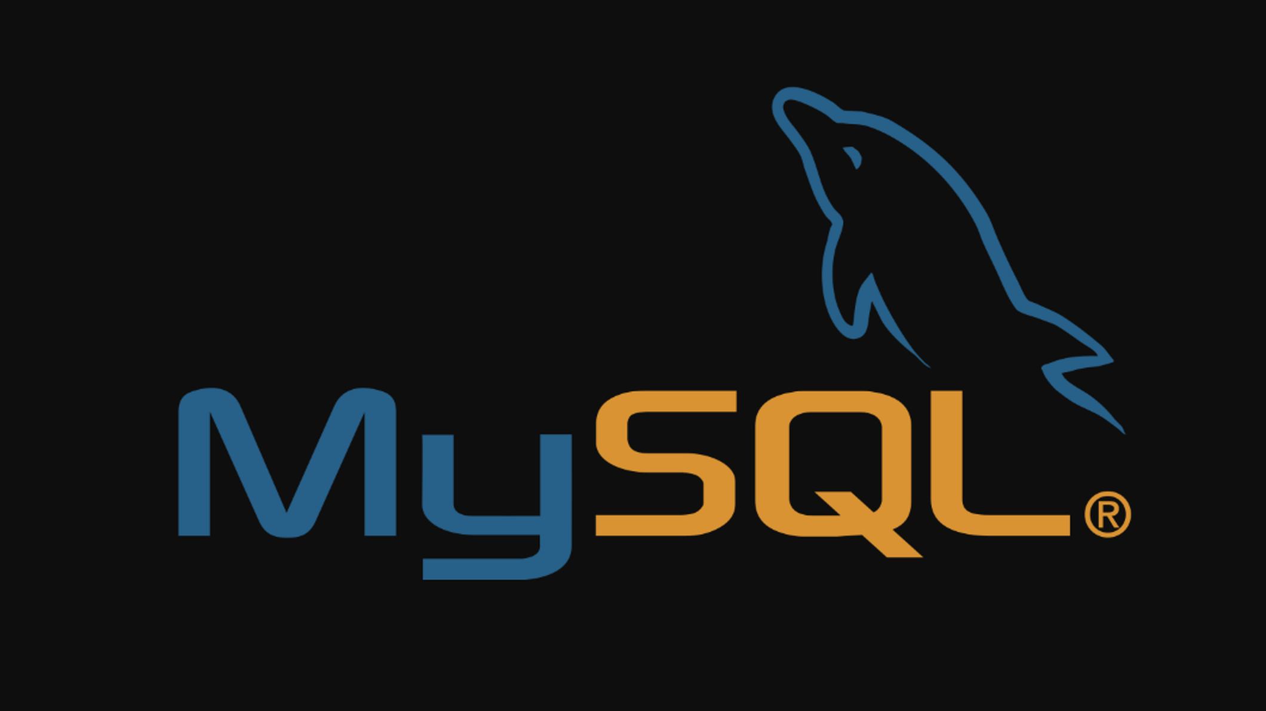
My-SQL
MySQL is a system that helps store and manage data efficiently. It's generally stores data in a structured fashion.
Main features associated with MySQL :
Open-Source
Quick and Reliable
Scalable
Secure
MySQL stores data efficiently in the memory ensuring that data is consistent, and not redundant
Scalability refers to the ability of systems to work easily with small amounts of data, large amounts of data
It provides a secure interface since it has a password system which is flexible, and ensures that it is verified based on the host before accessing the database
this software can be downloaded, used and modified by anyone. It is free-to-use and easy-to-understand

Slide 3
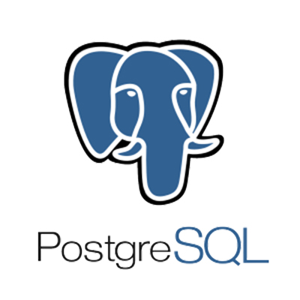
PostgreSQL
PostgreSQL is a powerful, open source object-relational database system that uses and extends the SQL language combined with many features that safely store and scale the most complicated data workloads.
Main features associated with MySQL :
Open-Source
Highly extensible
Highly Reliable
Secure
Active standbys, PITR (Point in time recovery)
It supports WAL (Write-ahead Logging)
Tablespaces
It includes several Authentications such as Lightweight Directory Access Protocol(LDAP), Generic Security Service Application Program Interface
this software can be downloaded, used and modified by anyone. It is free-to-use and easy-to-understand
MySQL stores data efficiently in the memory ensuring that data is consistent, and not redundant

Slide 4
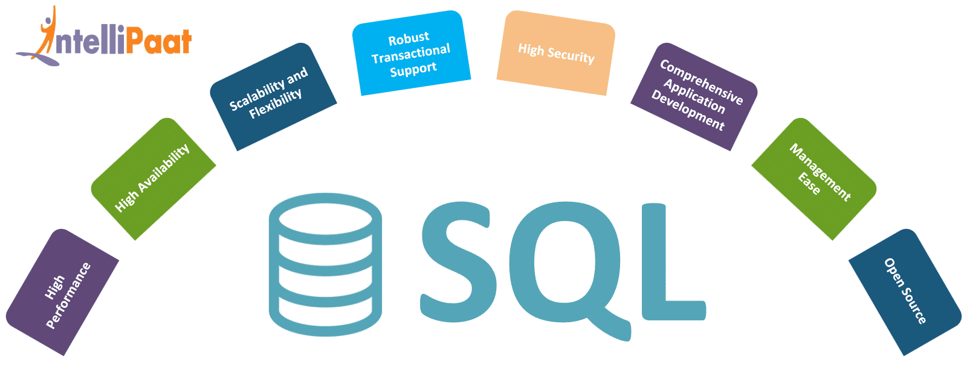
SQL Server
SQL Server is a relational database management system, or RDBMS, developed and marketed by Microsoft.
Main features associated with MySQL :
Database Engine
Reporting services
Data quality client
Secure
Reporting Services includes server and client components for creating, managing, and deploying tabular, matrix, graphical,
Provides a highly simple and intuitive graphical user interface to connect to the DQS server,
It provides a secure interface
SQL Server Database Engine includes the Database Engine, the core service for storing, processing, and securing data

Slide 5
Comparison
 | MySQL | PostgreSQL | SQL Server
Maturity | Initial release was in 1995 | Initial release was in 1989 | MSMS SQL Server for OS/2 was released in 1989 (together with Sybase) SQL Server 6.0 was released in 1995 marking the end of collaboration with Sybase.
Language | Written in C, has a few C++ modules | Written in C | Mostly C++ with a few exceptions
Cost | Open source / Owned by Oracle and has several paid editions | Completely free / Open source | SQL Server Express is a free edition, but it is limited to using 1 processor, 1 GB memory and 10 GB database files.

